Slide 1
Is there a way to increase the critical thinking skills of students?
Is Project Base Learning the teaching method for your students?
By Amanda Gardner

Slide 2
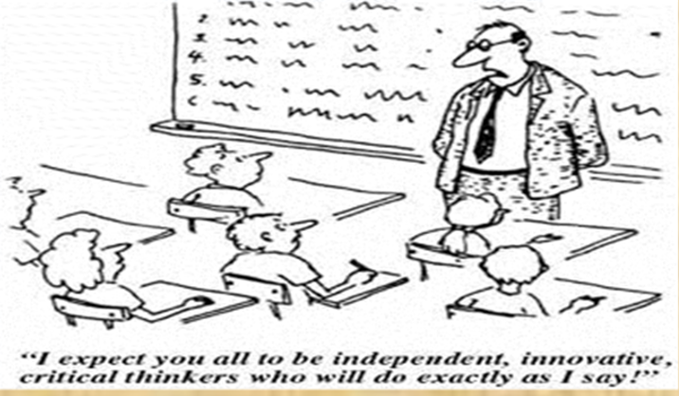
What was your teacher education program like?

Slide 3
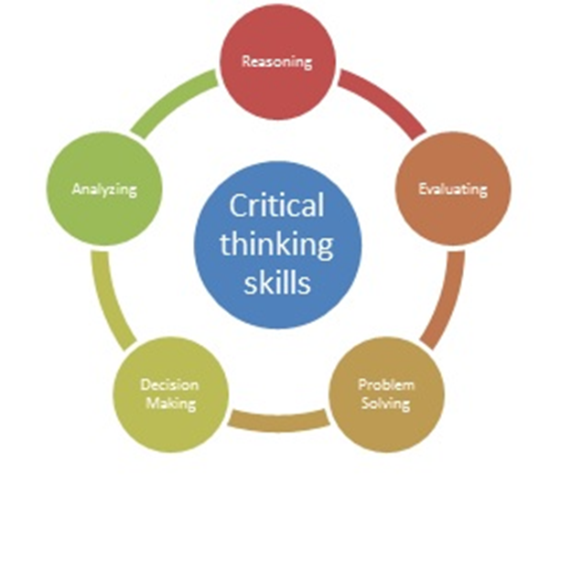
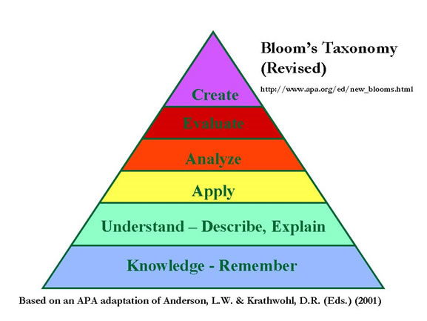
Is there another approach that could promote critical thinking in your classroom?

Slide 4
Project Based Learning might be what you are looking for?
Project-based learning (PLB) is a teaching method in which students explore a driving, real-world question through a student centered, interdisciplinary inquiry approach.

Slide 5
How can PBL help my students achieve more?
Engages students
Motivates students to learn
especially students struggling academically
Challenges students to think creatively
Promotes 21st century skills including
collaboration
communication
creativity/innovation
critical thinking skills (analyze, reason, evaluate, problem solve, make decisions)
Adaptability
Effective oral and writing skills

Slide 6
How is PBL different from traditional teaching methods?

Slide 7
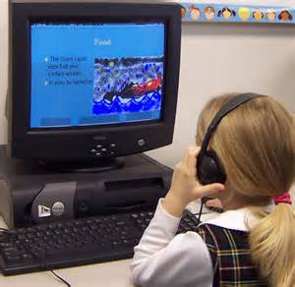
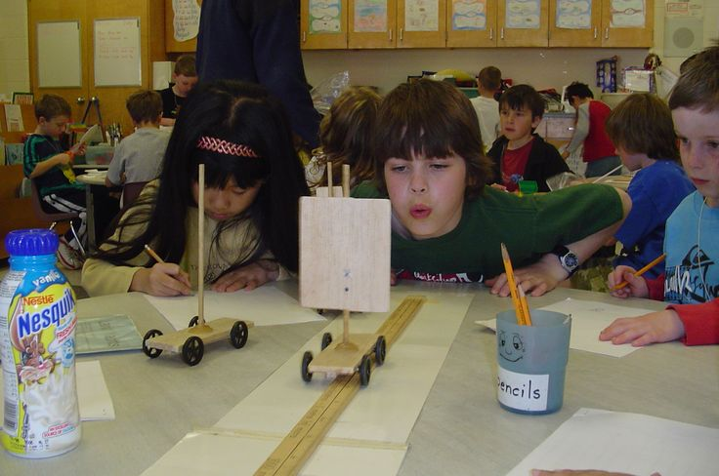
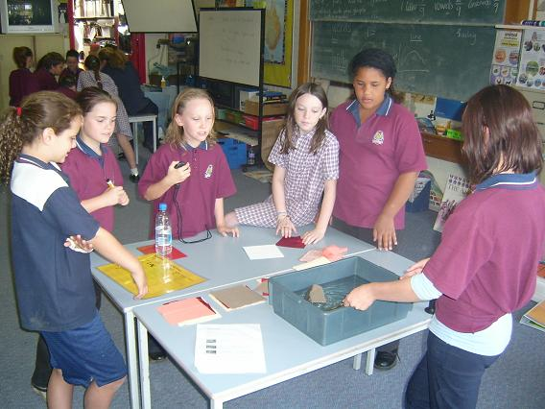
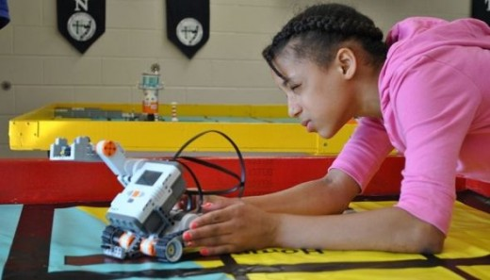
Would you want to be a student in a project based classroom?

Slide 8
Roles of the Teacher
Facilitator for student learning
Manage learning environment
Model strategies for thinking
Model strategies for problem solving
Work with students to create driving questions
Assess each students work and mastery of the standards embedded into the project.

Slide 9
Roles of the student
Collaborate effectively with group members
Manage the pace and self effort during the project
Research towards finding an answer to the driving question
Be a problem solver and investigator
Evaluate ones own work and their peers work
Create a way to showcase the results of the research
Master the standards through outstanding work

Slide 10
What does every PBL lesson need?
Start with the Essential Question
This helps the students to make a real-world connection.
Design a Plan for the Project
The project is planned by the teachers but students are given choice.
Create a Schedule
Timelines and benchmarks are set to guide students.
Monitor the Students and the Progress of the Project
Teacher facilitates and helps guide students throughout the project and through misconceptions.
Assess the Outcome
Student work is graded based on a rubric and presented publicly
Evaluate the Experience
Students reflect on their learning and the project in general.

Slide 11
Can your school embrace PBL?

Slide 12
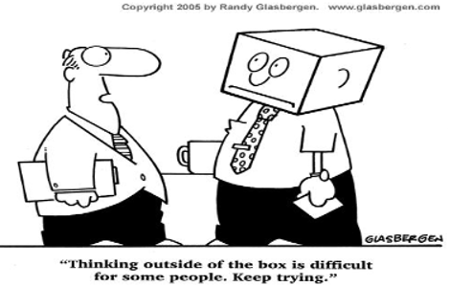
Can you think outside of the box when it comes instructional strategies?

Slide 13
Let’s Talk!
With your grade level team, discuss the videos and consider these questions.
Use your IPAD to record your groups answers and email them to your department leader.
How does your team feel about this approach?
What benefits do you see with this strategy?
What issues does your team see as hurdles with
implementing PBL?
What are the standards for your grade level that your team believes PLB would be most successful with teaching?
What standards for your grade level will not be compatible with PBL?

Slide 14
Things to do before we meet again…
Answer these questions for yourself and come ready to share…
Could your grade level try this strategy after testing?
What driving questions could fit into your standards?
What schedule changes might support our success with PBL?
What materials would be ESSENTIAL to making PBL a success?
What do you see as reasons why we should wait?
We will discuss these ideas during our department meetings that are scheduled in two weeks.

Slide 15
References
Edutopia www.edutopia.org
Buck Institute for Education www.bie.org
Video: BIE Project Based Learning: Explained December 9, 2010
https://www.youtube.com/watch?v=LMCZvGesRz8
Video: PBS New School Districts use Project Based Learning Over Testing April 3, 2013 https://www.youtube.com/watch?v=waKZQ9gaBkI
Images and cartoon are from Bing.com images and are being used for educational reasons

